Slide 1
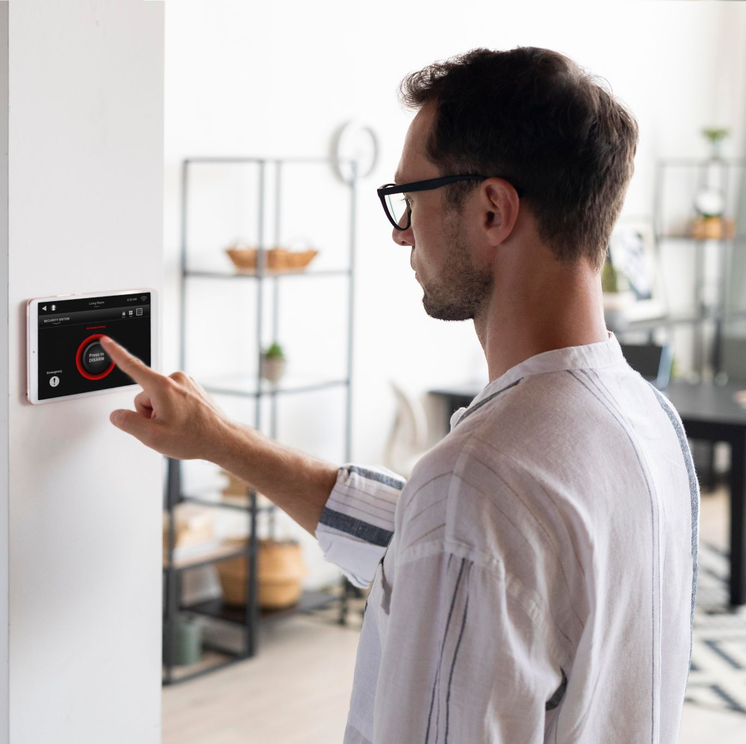
SMART HOME PROJECT Presentation

Slide 2
TABLE OF CONTENTS
ABOUT THE PROJECT
Mind Chart
01
04
Frameworks and Platforms
Schematic
02
05
Flutter App
Used Componotes
03
06
What’s our project ?
How was the flow of the project
The program connections and pins
Mobile app and ESP base and all theories
All needs to build the home
Smart Home Application

Slide 3
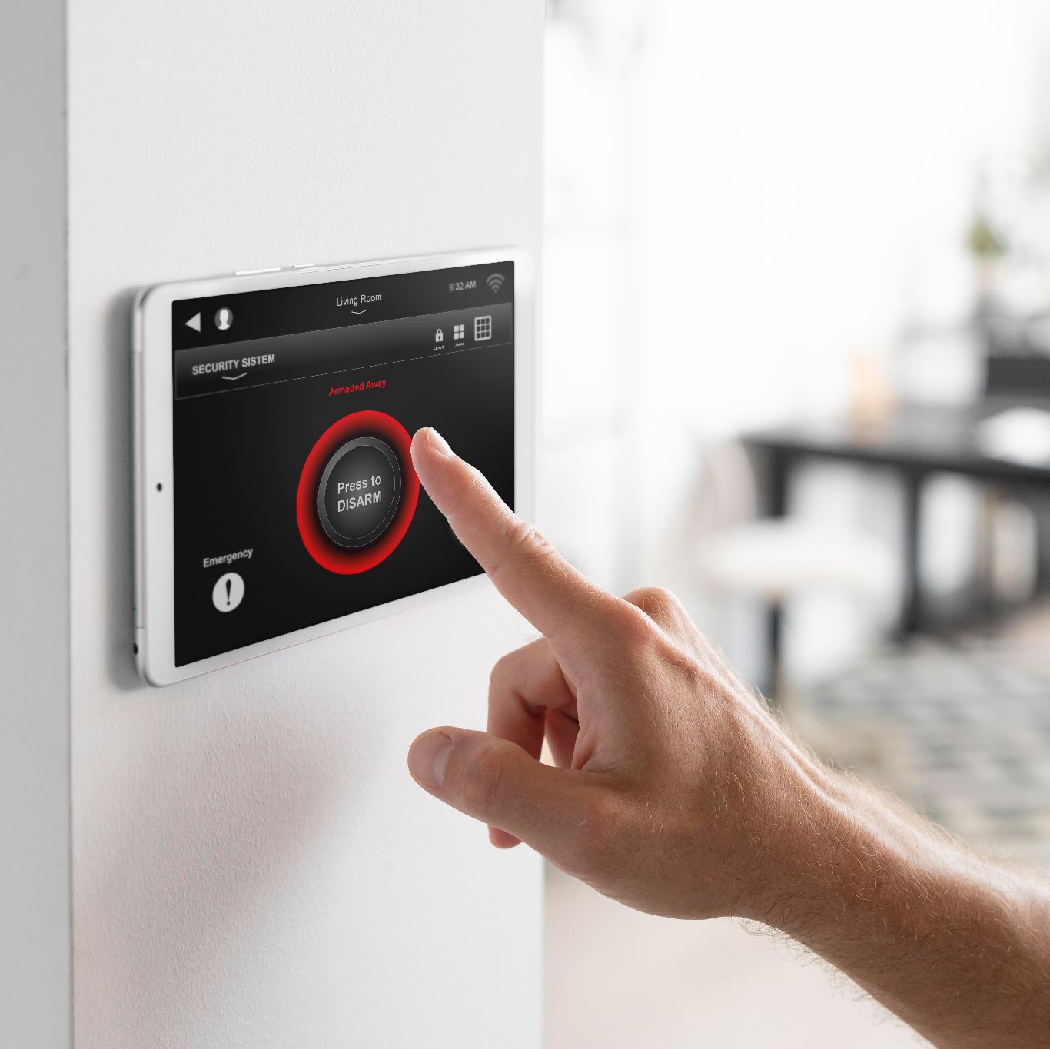
01.
About the project

Slide 4
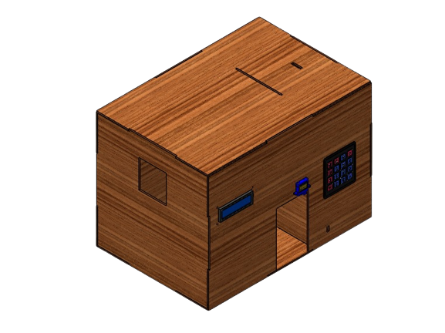
What’s the project?
A smart home system represents a straightforward yet remarkable living space equipped with advanced features. These features include the ability to identify flames in the event of a house fire, detect gas leaks, and sense water to prevent flooding. The system is designed to seamlessly integrate into your home and can be controlled through a dedicated application. This introduction lays the foundation for further discussions regarding the project.

Slide 5
ABOUT THE PROJECT
This project is built under the main points
The sensors and modules to run the program
The mechanism of the project
Used Platforms to set up Both home and mobile
How the program and phone will be up to date with any changes?
What’s the type of the used app to be up with Home?
Finally Results

Slide 6
02.
Frameworks Platforms

Slide 7

Arduino!
Arduino IDE is software for programming microcontrollers. It has a code editor, compiler, and uploader. You write code to control components like sensors and use the IDE to upload it to the board. It helps with debugging and communication with the board. For your smart home project, you'd use the Arduino IDE to program the microcontrollers for flame, gas, and water sensors.

Slide 8

Platform IO
A lightweight but powerful cross-platform source code editor
Smart code completions based on variable types, function definitions, and library dependencies
Multi-projects workflow with easy navigation around project codebase, multiple panes, and themes support

Slide 9

Flutter
Flutter is an open-source framework by Google for building beautiful, natively compiled, multi-platform applications from a single codebase.
It is easy programming language to set up phone applications and built-in functions make life easier for new developers to be up with new technologies

Slide 10

VS CODE IDE
VS Code is a powerful code editor. It's great for writing, debugging, and managing code. Its versatility and extensions make it a popular choice among developers.
It was the good choice to use combine between Flutter work, and Platform IO

Slide 11
03.
Used Componotes

Slide 12
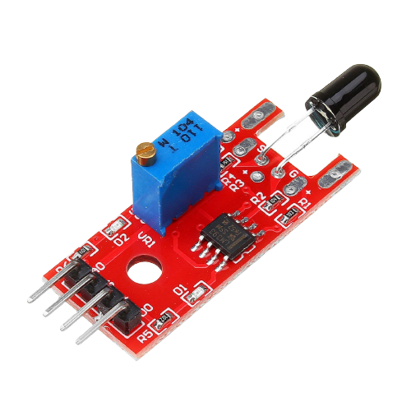
Flame Sensor
A flame sensor is a specialized electronic component designed to detect the presence of flames or fires. It works by responding to specific wavelengths of light emitted by flames. When a flame is present, the sensor generates an electrical signal that can be used to trigger various actions, such as activating alarms, shutting off gas supplies, or alerting a control system.

Slide 13
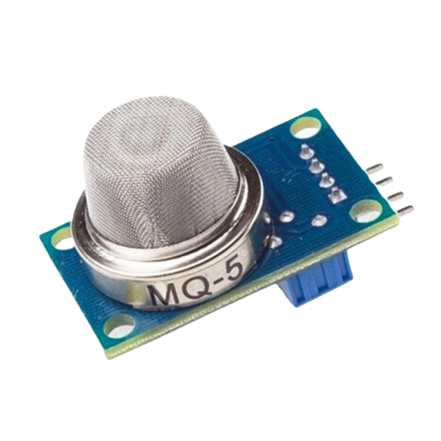
Gas Sensor
A gas sensor is a device that detects the presence of specific gases in the surrounding environment. It works by measuring the concentration of the target gas and generating an electrical signal that corresponds to its presence. Gas sensors are crucial for monitoring air quality, detecting leaks, and ensuring safety in various settings.

Slide 14
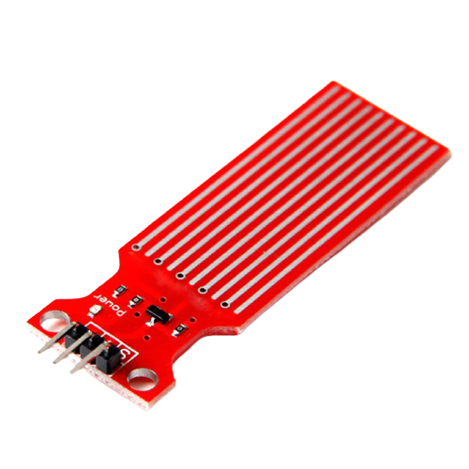
Water Sensor
A water sensor is a device designed to detect the presence of water or moisture in its surroundings. It works by sensing changes in conductivity or resistance caused by the presence of water. When water encounters the sensor, it triggers an electrical signal that can be used to activate alarms, notifications, or control systems.

Slide 15
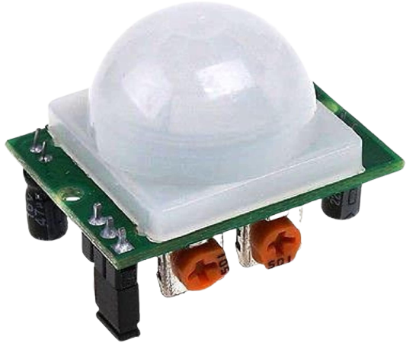
PIR Motion
PIR motion sensor, or Passive Infrared motion sensor, is a device that detects the presence of moving objects, including humans and animals, by sensing changes in infrared radiation in its field of view. It works by detecting the heat emitted by these objects, which changes as they move across the sensor's detection area

Slide 16
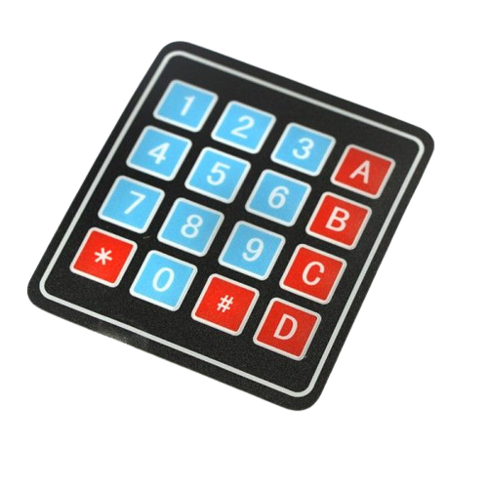
Keypad 4x4
A keypad is a set of buttons arranged in a grid, like a telephone's numeric keypad. It's used for inputting numbers, letters, or other characters into electronic devices or systems. Keypads are often seen in security systems, access control, and devices that require user interaction, So we use it to make the user send the needed password to start running home as a key for opening the door.

Slide 17
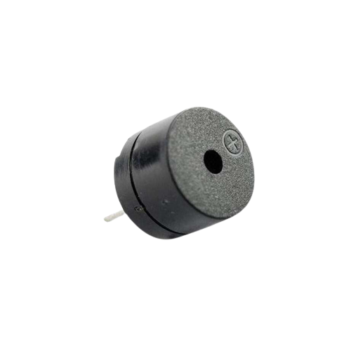
Buzzer Act.
A buzzer is a simple sound-making device that produces a distinct tone or sound when it's activated. It's commonly used to provide audible alerts or notifications in various applications, and we used it to make sound when detecting threshold for all sensors in home

Slide 18
Locations at home for sensors
Flame Sensor
Water Sensor
Gas Sensor
Motion

Slide 19
04.
Mind Chart
How will the program work?

Slide 20
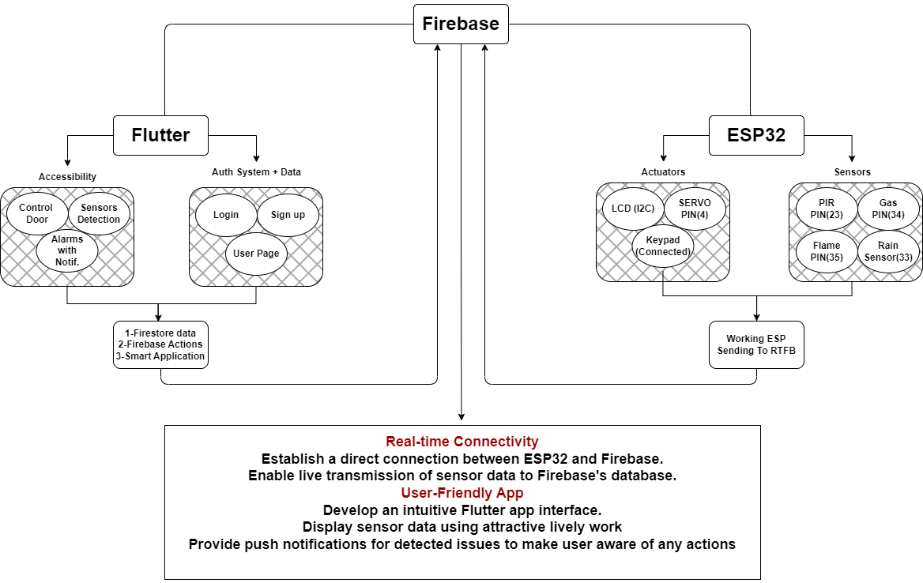
Mind Chart

Slide 21
05.
Schematic
How all of them connected together?

Slide 22
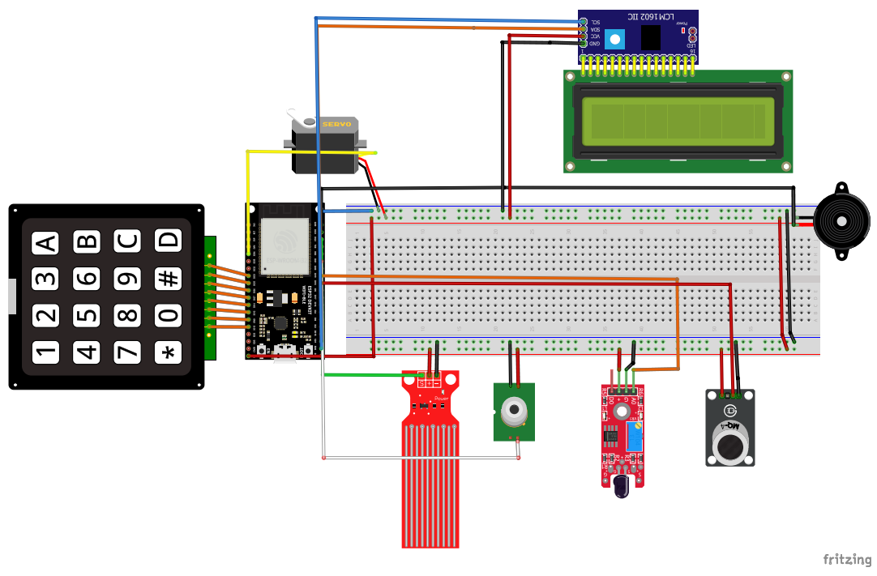
Schematic

Slide 23
Fast information
Did you know that?
While we all know that MQTT is used for Data transmission, Firebase Doesn’t use MQTT PROTOCOL!!

Slide 24
Firebase primarily uses its own real-time database and Firestore as its real-time database solutions, and these don't use the MQTT (Message Queuing Telemetry Transport) protocol by default.
Firebase Realtime Database uses a WebSocket-based protocol to maintain real-time synchronization between clients and the database, while Firestore uses a combination of WebSockets and HTTP/2.

Slide 25
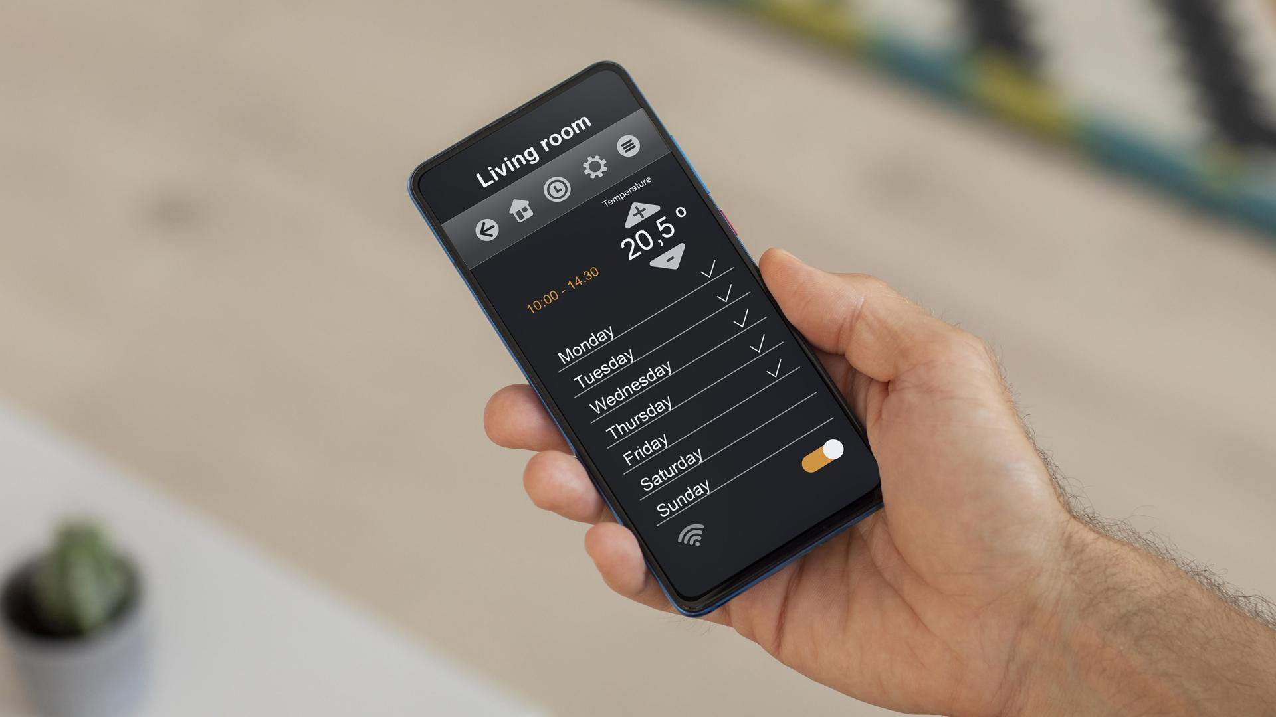
Smart Home Application
06.
Your Own Key app!

Slide 26
Our Application
The app features 7 screens, with each slide focusing on a single screen. The app's primary purpose is to establish a secure connection between the user and their home, ensuring they're informed about home activities whether they're inside or away.

Slide 27
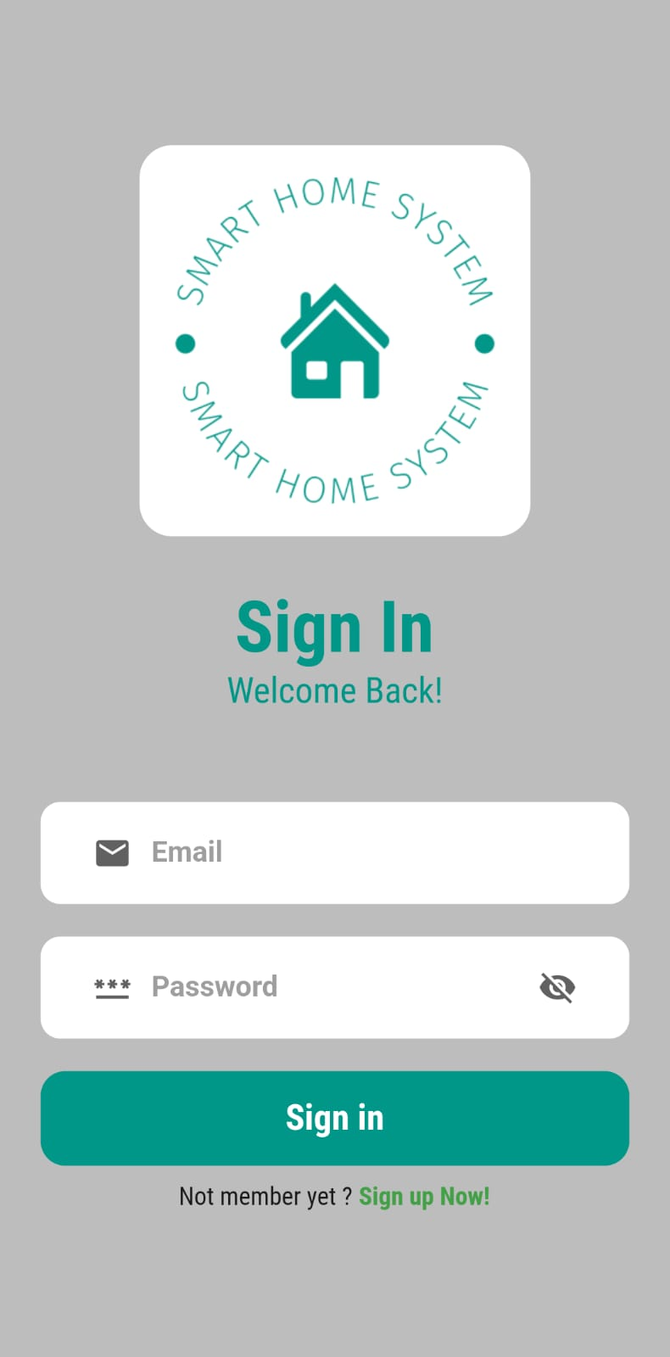
Sign in Screen
The "Sign In" screen is the entry point for users. Here, they provide their credentials to access the app, ensuring only authorized individuals can control and monitor their home remotely.

Slide 28
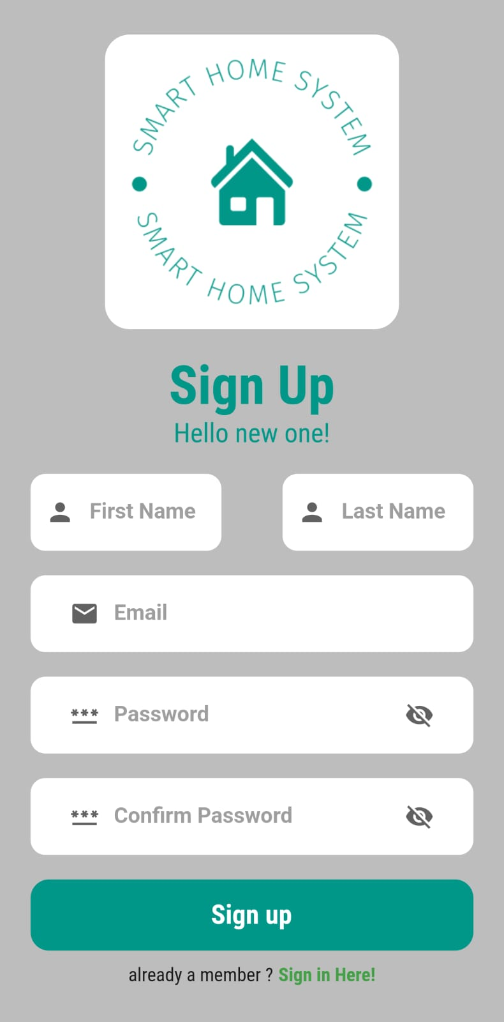
Sign up Screen
The "Sign Up" screen allows new users to create accounts. By providing the necessary information, users can register and gain access to the app's features, fostering a personalized connection to their home's safety and updates.

Slide 29
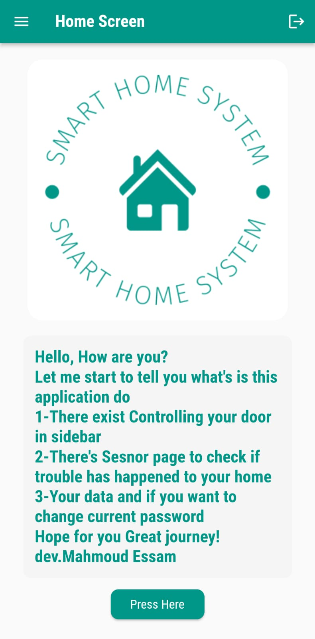
Home Screen
The "Home" screen serves as the central hub of the application. It encompasses several key functionalities:
Door Control System: This feature lets users remotely control their home's doors. They can lock or unlock doors as needed, enhancing security and convenience.
Home Sensors: The app displays real-time data from various home sensors. This includes information from flame, gas, and water sensors, offering a comprehensive view of potential risks.
User Information: Users can access and manage their personal information from this screen. It provides a way to update contact details and preferences, ensuring accurate notifications.
Developer Information: This lets the user know who developed that application and home and project at all

Slide 30
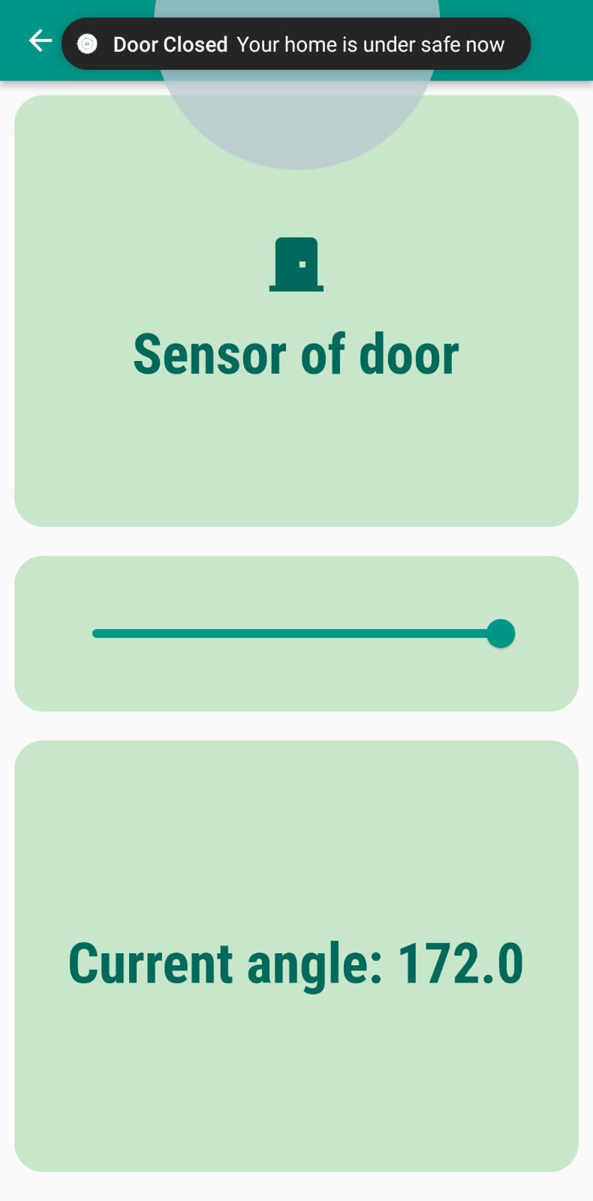
Door Control
The "Door Control" screen lets users remotely manage access by verifying chosen values to indicate whether the door is closed or open. This empowers convenient control over home security.

Slide 31
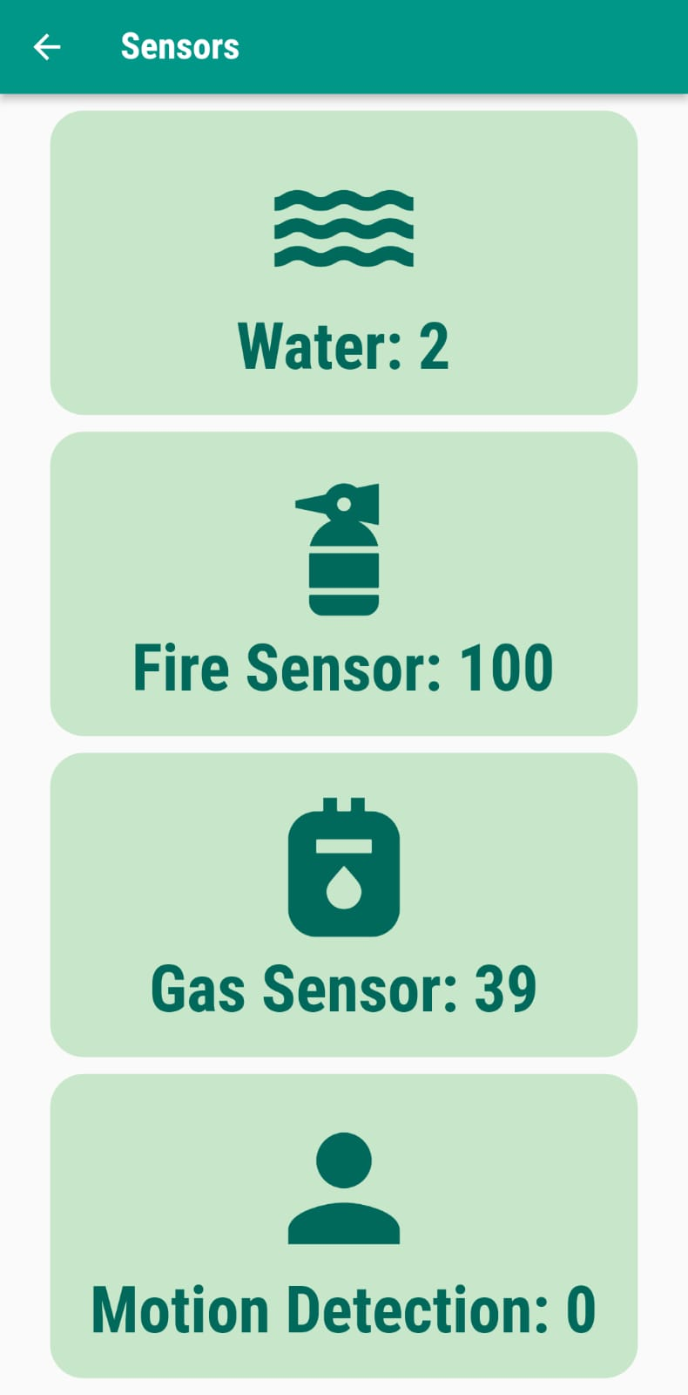
Sensor Page
The "Sensor Page" delivers real-time readings from a range of sensors, including those for water, flame, gas, and motion. This comprehensive display equips users with vital information about their home's safety and conditions.

Slide 32
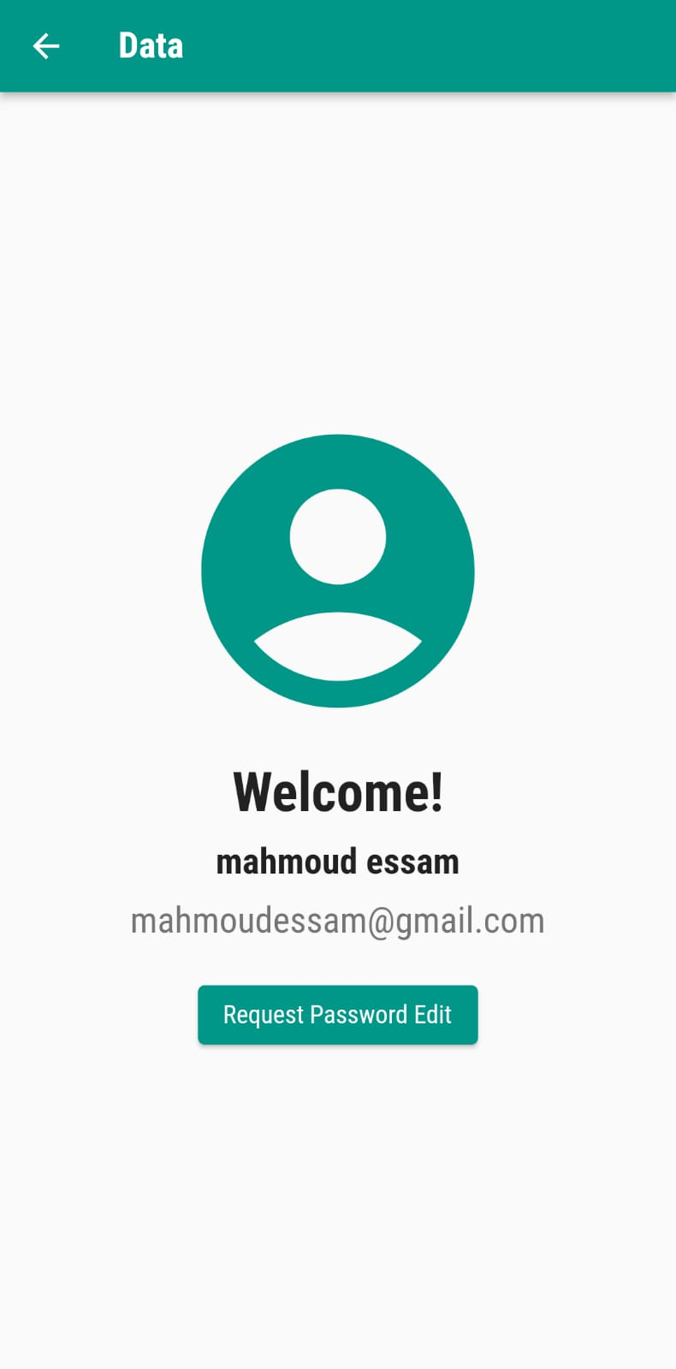
Information
The "Information Page" presents users with essential details about their profile and preferences, ensuring accurate communication and personalized experiences within the app.
And ability to change password if user forgot it sure.

Slide 33



OUR TEAM
Zeyad Ashraf Hafez
TL : Mahmoud Essam
Ziad Ashraf Ebrahim
ID : 20221374025
ID : 20221460231
ID : 20221369225

Slide 34
Thanks for listening!!

